Slide 1
WEATHER/ATMOSPHERE AND HAM RADIO IMPACTS
By Mel Zeldin

Slide 2
SUMMARY OF TOPICS
Radio frequencies vs atmospheric and weather impacts
Atmosphere/atmospheric layers
Importance of ionosphere
Wave scattering by molecules
weather variables and impacts on radio waves
Inversions and ducting
Other factors: precipitation, thunderstorms, humidity, clouds, etc.

Slide 3
Radio Wave propagation modes

Slide 4
Radio Wave propagation modes

Slide 5
Atmospheric layers
And importance of ionosphere

Slide 6
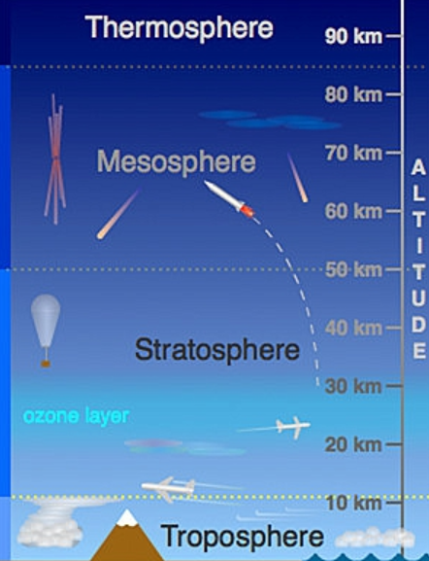

Slide 7
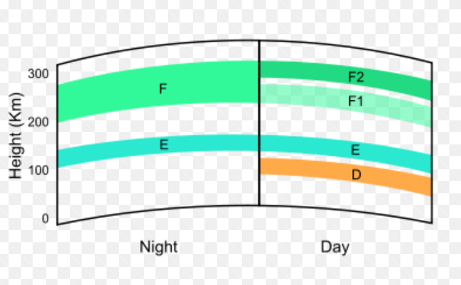
IONOSPHERIC LAYERS

Slide 8
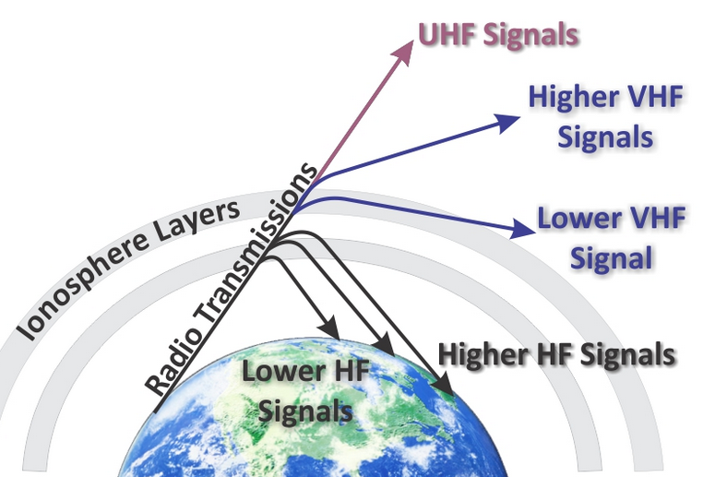
IONOSPHERIC LAYERS AND RADIO FREQUENCY IMPACTS

Slide 9
scattering
By atmospheric molecules

Slide 10
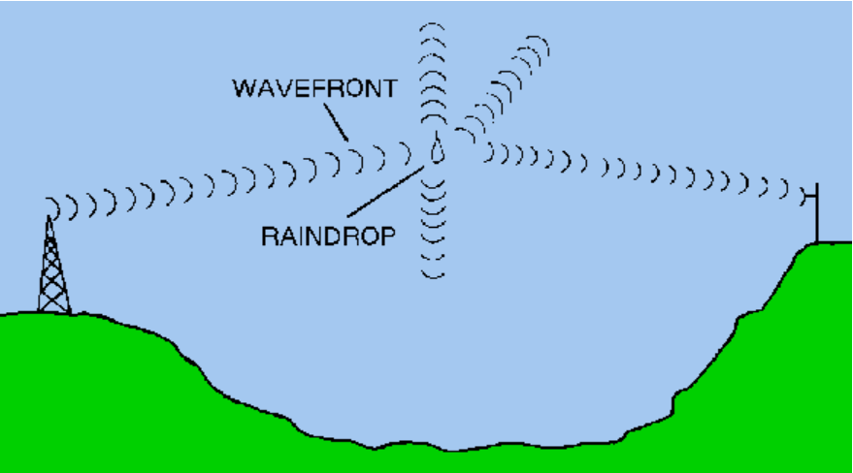

Slide 11
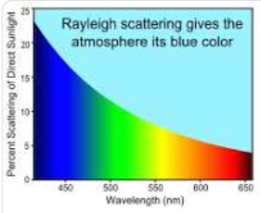
WHY IS THE SKY BLUE?
WHY DOES THE SUN APPEAR RED AT SUNSET?

Slide 12
Low level inversions
What is an inversion?
When cooler air at the surface is trapped beneath a layer of warmer air aloft

Slide 13
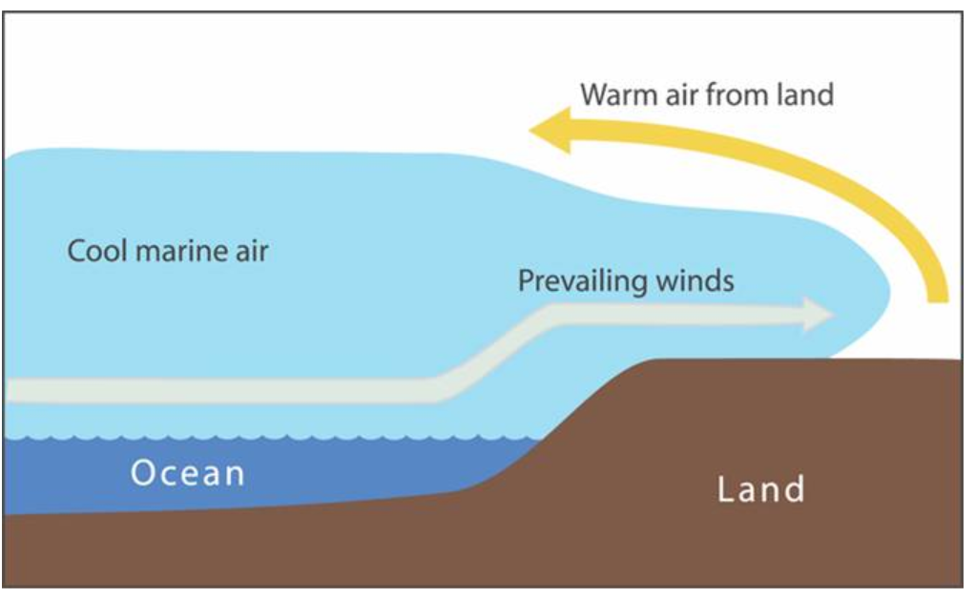
Low-level temperature inversions (conducive to uhf ducting)
MARINE
INVERSION

Slide 14
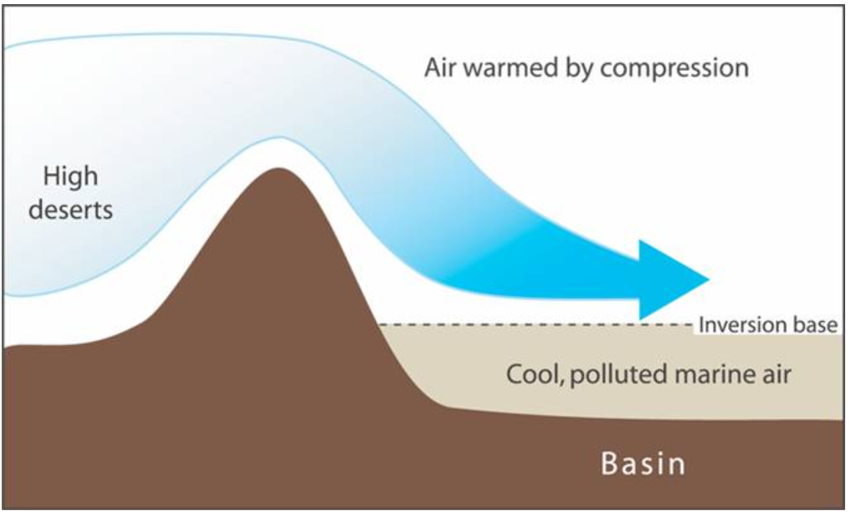
Low-level temperature inversions (conducive to uhf ducting)
SUBSIDENCE
INVERSION

Slide 15
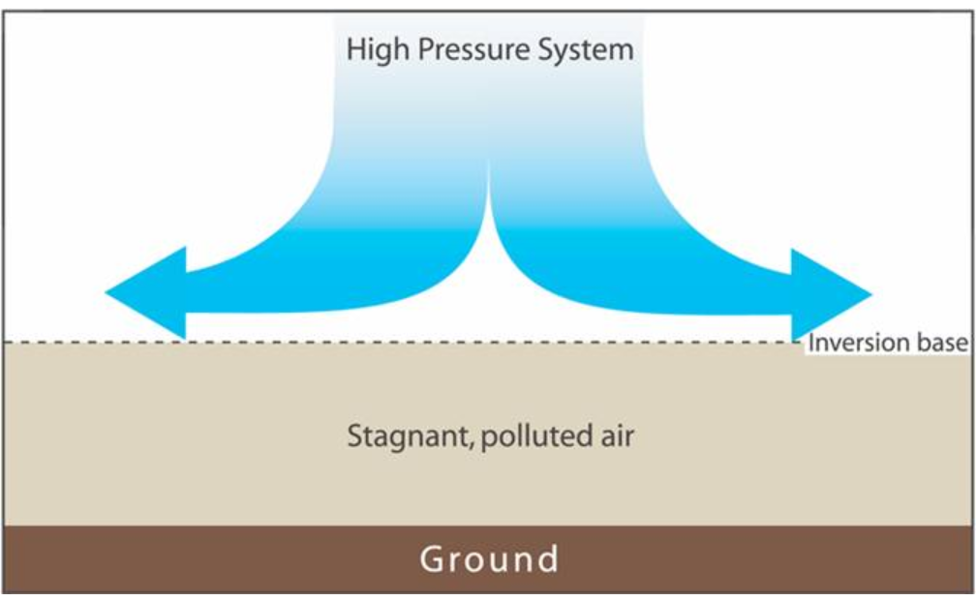
Low-level temperature inversions (conducive to uhf ducting)
HIGH
PRESSURE
INVERSION

Slide 16
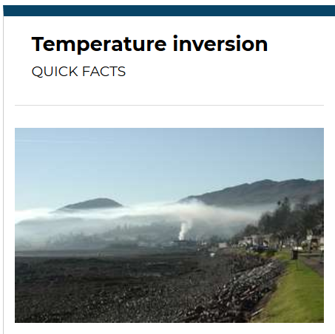
Visual of low level temperature inversion

Slide 17
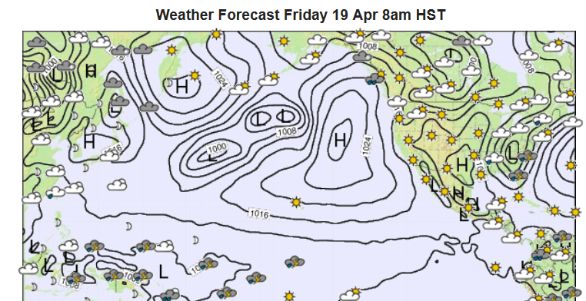
TYPICAL SUMMERTIME WEATHER MAP

Slide 18
Inversion characteristics
Varies in intensity based typically on the degree of downward air movement on the east side of the pacific high pressure system
Varies in height based on the degree of both temperature and pressure gradients between the coast and the deserts
When there is spring or summer morning fog in Beaumont, it typically means the base of the inversion is above us. If it is clear, the inversion GROUND-BASED and WEAKER than in the basin

Slide 19
INVERSION DUCTING

Slide 20
Other weather factors
Thunderstorms can cause some signal attenuation and background noise
Rain, snow, fog, and humidity can attenuate radio signals, but typically at the GHz frequencies.

Slide 21
